Slide 1
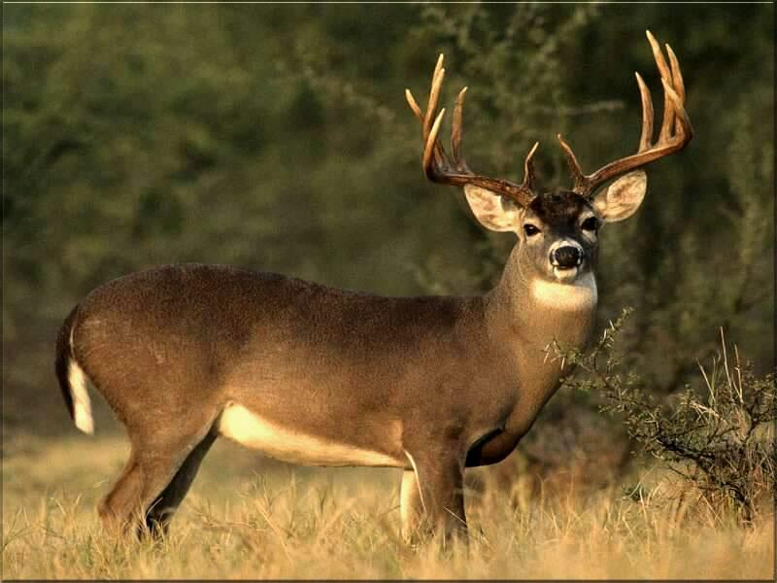
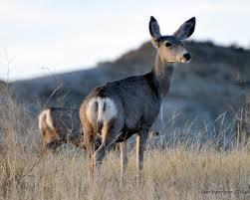
Mule Deer-Buck
Mule Deer-Doe

Slide 2
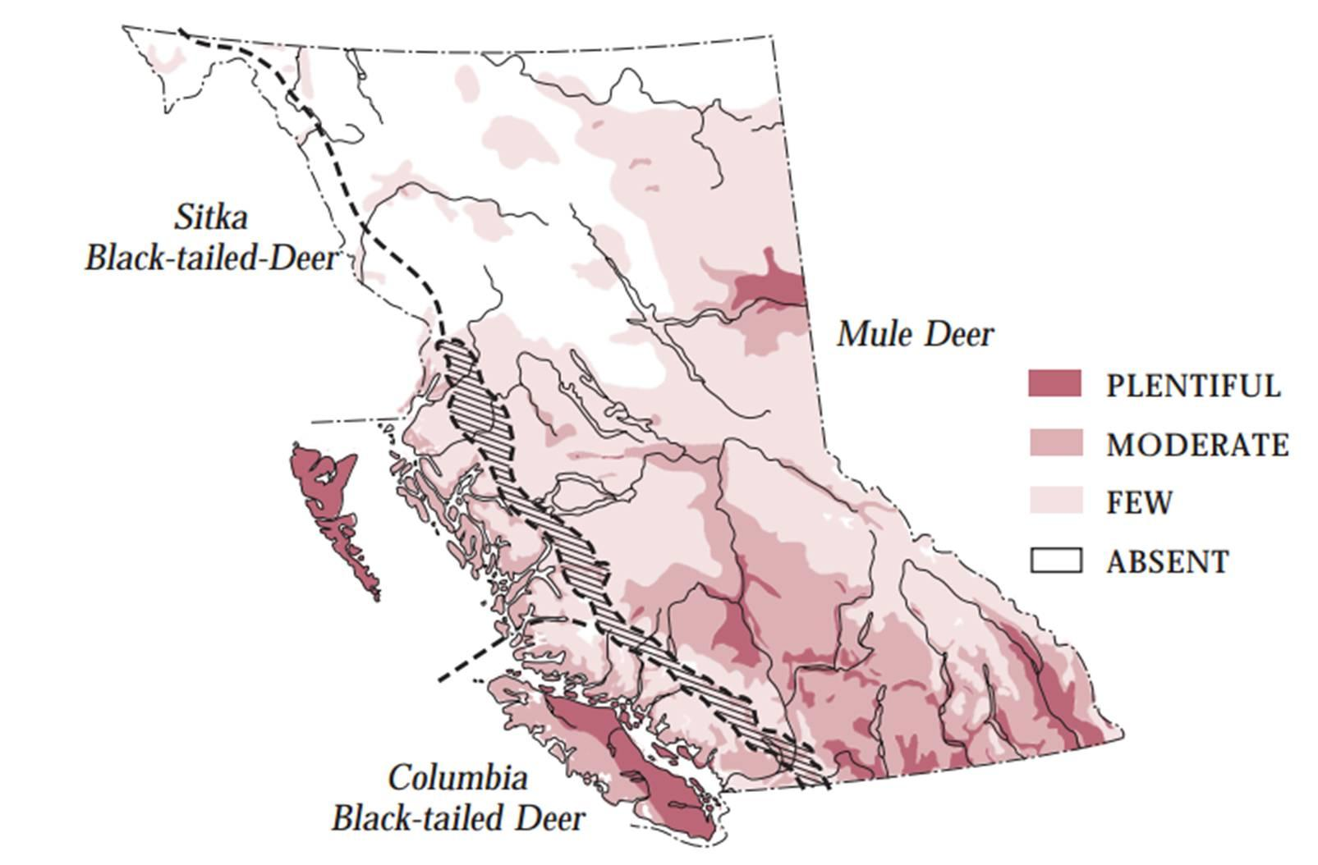
2. Location/Distribution/Habitat in B.C
Mule Deer live in a broad range of habitats - forests, deserts, and brushlands. Mountain populations migrate to higher elevation in warmer months, looking for nutrient-rich new-grown grasses, twigs, and shrubs. They maintain separate summer and winter ranges, connected by a migratory pathway. In milder climates, they do not migrate.

Slide 3
3. Body Size and Characteristics
Sexual Dimorphism: "Males are usually heavier than females. "
Length:
Range: 1.3-1.7 m males; 1.3-1.6 m females
Weight:
Range: 40-120 kg males; 30-80 kg females
Unique characteristics” Big Ears, White Tail with Black Tip, Forked Antlers.

Slide 4
Food and Enemies
Food: Mule Deer are browsers eating mainly leaves and twigs of woody shrubs, they will also eat weeds…
Enemies: coyotes, wolves and cougars.

Slide 5
5. Interesting Facts
Mule Deer make a variety of noises:
snort
grunt
cough
roar
whistle

