Slide 1
Ch 5 Changes in the Prairies

Slide 2
5-1 Introduction

Slide 3
Learning Outcome- Today you will learn about the importance of historical images. You will practice analyzing images.

Slide 4
L.M- 5.1
Analyze- Break down into parts
Identify- Notice interesting or unique words or items.
Read-- Read and summarize important text.
Evaluate- determine the worth, value or importance of image.

Slide 5
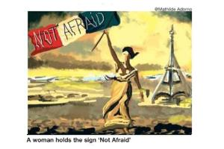
Practicing the AIRE Method: Pg. 366 Times of India

Slide 6
Individually complete L.M. 5.1 Analysis..
20 minutes
Discuss as class..

Slide 7
Read 166-168
Text Assignment:
1. What rights and privileges were given to the Metis in Manitoba?
2.How did the Militia treat the Metis?
3.What was Scrip? How was it used?
4.Use your image analysis technique for Figure 5-1.
5. What happened to the Metis as a result of land speculation and the loss of the buffalo?

Slide 8
5-2 - The Metis Move North and West..

Slide 9
The Laws of the St. Laurent
Read

Slide 10
What would life be like without laws?
Think about the possibilites.
Write down 2 results of life without laws...

Slide 11
Learning Outcome: Today we will identify the laws of the Metis in the Northwest, and analyse different opinions on these laws..

Slide 12
Read Quietly Pg 169-170-
Write down 2 laws of the Metis laws in the Northwest.
Why would Canada be opposed to the Metis making laws?

Slide 13
L.M 5.3 Analysing View Points
Were the Laws of the Metis Unreasonable?
Two sides to the story...

Slide 14
You will be assigned a role to analyze..
Please fill in all of the information.
Meet with your partner...
Add the opposing sides information.
1. How is each account biased? If you had to choose one to believe, which would you choose? Why?
2 How do the accounts support and contradict each other?

Slide 15
Text Assignment:
Read 172-173
Describe the demise of the bison..

Slide 16
5-3--- First Nations Treaties and The North West Mounted Police

Slide 17
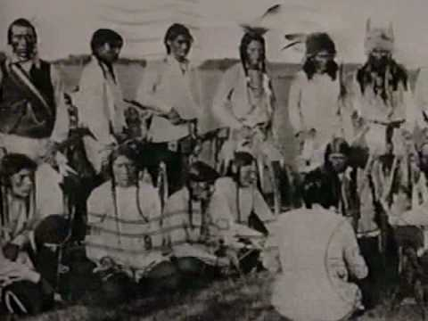

Slide 18
Learning Outcome:
Today you will learn about the treaty process in Canada, and the importance of the NWMP in early Canada.

Slide 19
Read 174-179
Individual Seat Work---
Complete Section 2 and 3

Slide 20
5-4 The Northwest Rebellion
PGS. 181-186

Slide 21
Learning Outcome: Today you will learn about the causes, effects and results of the Northwest Rebellion.

Slide 22
Recognizing Cause-Effect and Result Pg. 362
Think about the Vancouver Canuck riots--
Write down causes,effects and results..
Join a partner-- share your info.
Discuss as a class.

Slide 23
Read Pages 181-185
As you read fill in a 3 column organizer:
Headings:Cause/Effect/Results

Slide 24
Join back up with your partner from earlier together determine if you have right idea.
Add to your list of causes, effects and results....
Share as a class...

Slide 25
Homework--Fill out GLM-12 Completely and Neatly Filling in all of the information boxes

Slide 26
5-5 The Trial of Louis Riel

Slide 27
Are innocent people charged and convicted of crimes?
Discuss.

Slide 28
Can you think of an example where an innocent person was convicted of a crime?
What if the sentence was death?

Slide 29
Learning Outcome:
Today you will learn about the trial of Louis Riel..
You will be able to understand the charges laid against him and the two opinions about his guilt.

Slide 30
Innocent until proven guilty means:
a. that the prosecution lawyers must prove you committed the crime.
b. that you are immediately put in prison until proven innocent.
c. that your guilt is assumed.
d. all Canadians have the right to a lawyer.

Slide 31
What was Louis Riel charged with?
Read Pg. 187
From this chapter and the previous one find evidence of treason...(crime against your country)
Write down at least three pieces of evidence
Share with a partner..

Slide 32
The trial consisted of a jury of only 6 none of which were French, Riel was convicted and sentenced to death.. Read Statement on Page 187
Do you agree with the conviction?

Slide 33
Use GLM 18 to Assess different Viewpoints on Riel's guilt.
Use the following two people as examples of the different opinions:
John A MacDonald-Against Riel
Gabriel Dumont- For Riel
Complete the entire sheet...

Slide 34
5-6 - The National Dream
Building the CPR

Slide 35
Learning Outcome:
Students will analyse the process of the CPR completion and determine why the National Policy was so important to Macdonald..

Slide 36
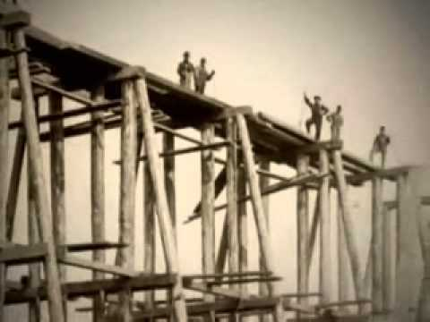

Slide 38
USE GLM -9-194-201
Answer
Who were the main builders of the CPR- what were their roles..
What was the purpose of the CPR? What were problems/dangers?
Where was it built? Why?
When was it started? When was it finished?
Why did it take so long? Why did money cause many problems?
How was it used? How did it get finished ahead of schedule?

Slide 39
Text Assignment:
1. What was the National Policy? Why was it so important to Macdonald and Canada?
Answer Figures: 5-28,29 and 30

Slide 40
Summative Activity for Changes in the Prairies
Using your notes create a summative poster reflecting the changes to Canada during this time period you must address at least 3 of the following topics:
1.The Metis and Land Rights (Scrip)
2. The Treaties
3. The Northwest Rebellion
4. The Trial of Louis Riel
5. The building of the railway (CPR)
Instructions:
You must identify what Canada was like before the event.
You must describe the change that occurred in Canada.
You must give your opinion on the results. Were the results positive or negative for Canada. Explain.
You must demonstrate your understanding on a large piece of paper in whatever format you wish” You can write an essay.
Draw pictures and label.

Slide 41
Rubric: Fully Meeting 3 events. Meeting 2 events. Minimally Meeting 2 event.
4- You clearly identify in detail what Canada was like before the change or event. You describe in detail the changes that occurred. You give your opinion on the results with examples that are both positve and negatives and explain clearly your view point on how the changes have effected Canada.
3. You clearly identify in detail what Canada was like before the change or event. You describe in detail the changes that occurred. You give your opinion on the results with examples that are both positve and negatives and explain clearly your view point on how the changes have effected Canada.
2-You identify some of the detail what Canada was like before the change or event. You describe in minimal detail the changes that occurred. You give your opinion on the results with examples that are both positve and negatives and explain your view point on how the changes have effected Canada.

