Slide 1
If you need to speak to the teacher please do not do this..

Slide 2
CH 1
A Different Canada

Slide 3
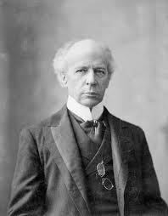

Slide 4
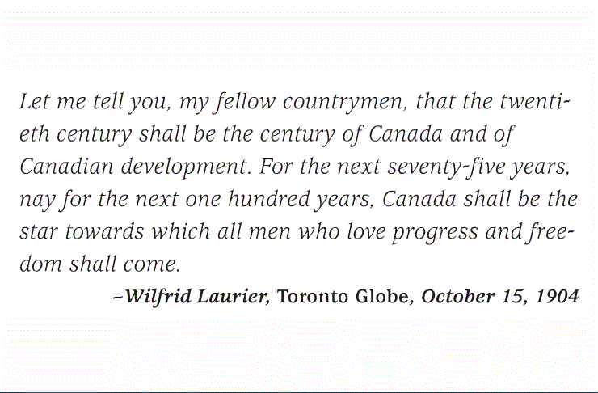
Who is Laurier, whose century would it be? How was Canada different back then? Pg 5

Slide 5
Learning Outcomes:
You will learn about early Canada and be able to identify and explain our unique cultural and political characteristics--

Slide 6
What is culture?
What are political characteristics?
Talk with a neighbour and give some examples of the culture and political characteristics of Canada….

Slide 8
Text Reading:
Quietly Read Pages 5-9
As you read jot down an idea or two on how the following influenced Canadian culture and politics: (1) immigration,(2) British Influence, (3)Women and (4)Quebec Nationalism

Slide 9
Vocabulary: For each Word give an:
Explanation,Example,Visual
a.Autonomy
b.Ethnocentric
From what you have read so far how did the shifting culture lead Canadians to be more autonomous and often ethnocentric?

Slide 10
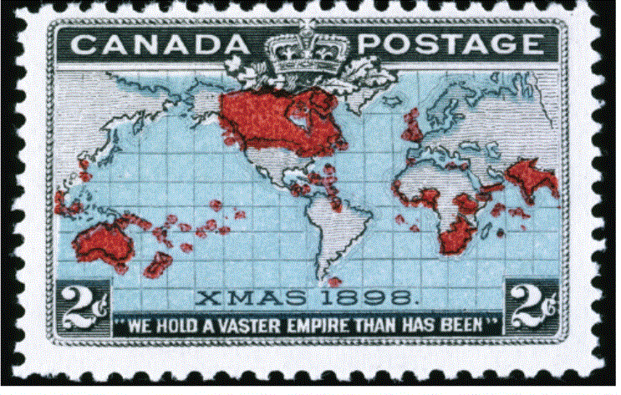
Fig 1-3- The British Empire was the biggest of the European empires, that controlled much of the land and people of the world. What does the expression "the sun never sets on the British Empire " mean?

Slide 11
Homework Questions:
Write down and answer the following Questions into your notebook.
Pg. 6- Society Identity:"How did women....
Pg. 7- Autonomy " What was Canada's.....
Pg.8- Society Identity " Why were the attitudes of
Answer each of these questions in full sentences..

Slide 12
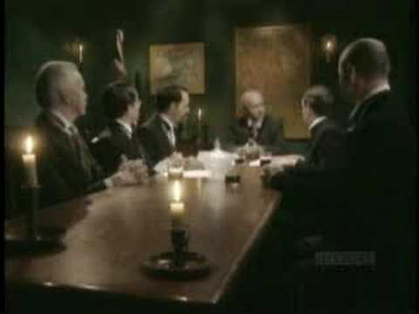

Slide 13
1-2 Canada's Changing Population

Slide 14
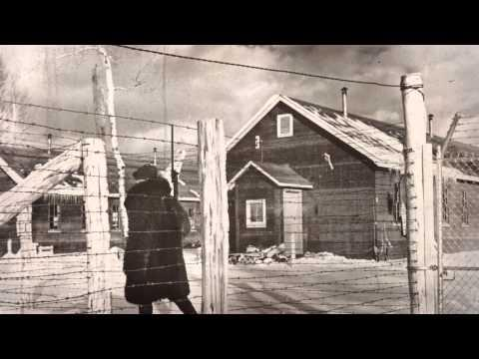

Slide 15
Think about and be Prepared to Answer.. Review from Last Day
How is Canada still British?
How are women influencing life in Canada during the early 2000's?
How are the French and English getting along today?

Slide 16
Today we will learn about how the Canadian Government dealt with immigration…
Provincial PLO: 3a-assess the development and impact of Can.
social policies and programs related to immigration.

Slide 17
Read Pages 9-12- As you read focus on the following:
Identify government policies with regards to the different immigrant groups.

Slide 18
You will be given a number 1-3
Your number represents either: (1)Chinese,(2)India, or (3)European
Identify three or four ways groups were treated unfairly by the government or Canadian Citizens
Share this info with your group
Record info in your notebook

Slide 19
Homework Assigment 1-2
Society/Identity Questions
Pg. 9 (2 questions)
Pg. 12 (1 question)
Definitions--Assimilation
Practice Questions:
Pg. 12- 3,4
Figure 1-5 (2 Questions)
Extra-http://news.nationalpost.com/2013/12/27/as-canadian-citizenship-rules-face-an-overhaul-by-the-harper-government-in-2014-heres-what-to-expect/
What is the issue? What is your point of view?

Slide 20
1-3- Challenges Faced by Aboriginals
Pg 13-16

Slide 21
Provincial Outcome 3E-Demonstrate knowledge of challenges faced by Aboriginals and their response to reserves, self government and treaty negotiations.

Slide 22
Review Questions from last day
How did the current governments of Canada respond to the Komagata Maru and Head Tax ?
a. the government ignored
b. the government said sorry
c. the government said sorry and gave financial compensation
d. the goverment put it to a vote.

Slide 23
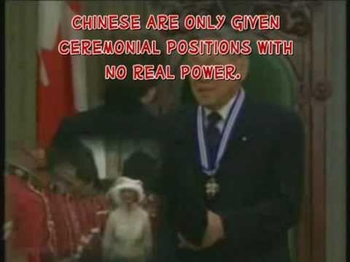
Review from Last Class

Slide 24
Quietly Read Pages 13 and 16.

Slide 25
http://www.youtube.com/watch?v=WLnBZgdbSyc

Slide 26
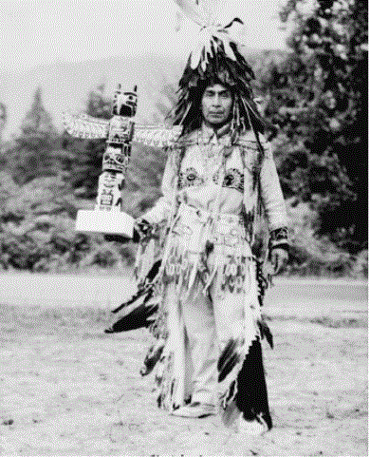
Who is this?

Slide 27
Who's Who- GLM- 6
Skill-Analysis
Criteria:
___Accurate info. for each quest.
___neat
___comprehensive answers
___thoughtful answers
___Creative (Drawing,i Ilustration)
___ Google Capilano- Find out something about how he has impacted Vancouver.
Assignment Mark on:
6-Exceeds expectations above
5-Meets all above expectations to a high standard
4- Meets all above expectations to a good standard
3-- Minimally meets above criteria
1/2-does not meet criteria.

Slide 28
On the back of GLM-6 Answer the following questions based on Page 16:
1. Define urbanization.
2. What led to more jobs in the cities?
3. What happened to the population of Winnipeg?
4. Describe the many differences between the wealthy and poor ?

Slide 29
1-4 Canadian Economy and Resources in the Early 1900's

Slide 30
Provincial Learning Outcome:
3B-
Identify the causes and effects of economic change in Canada..

Slide 31
Read 18-21

Slide 32
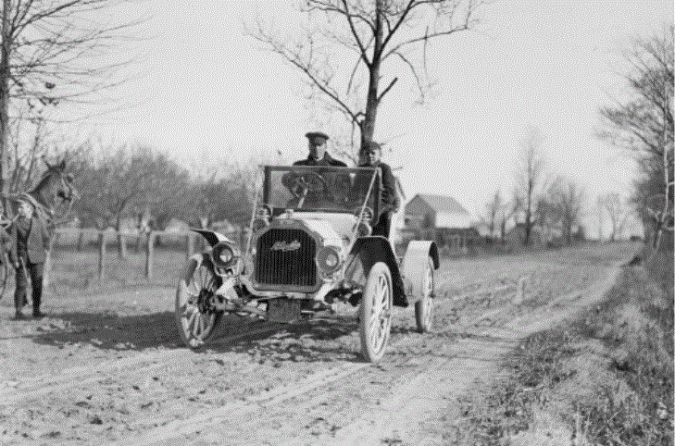
How much was this car worth?

Slide 33
Cause and Effect
Use GLM-13 to illustrate some effects 0n Canada:
Fill these ideas neatly in the Left Boxes.
1. Availability of Electricity..
2. Corporate Giants with no competition..
3. Extraction and use of the Environment..

Slide 34
Cause and Effect:
In the right side of the organizer list effects......3 or 4
For example---Electricty caused factories to be powered

Slide 35
Assignment Part 2
1.Complete key terms page 19.
2. Economy/Geography- Pg 18 and 20
3. Practice Questions
#2, and #3- Page 21
Critical Inquiry Page 21....
4.Read- Athabasca--Oil Sands
Answer Thinking Crit.. 1-16

