Slide 1
Chapter 12-1
Living Standards in a Changing World

Slide 2
Learning Outcomes
Today you will learn about the HDI and how it measures a country's development.

Slide 3
Task 1: Look at Figure 12-1
Read Pg. 388.
Why do you think the three criteria were chosen to measure living standards.
Answer--- Thinking Critically Question..
Discuss with class.....

Slide 4
Task 2..
Create a chart with the following headings:
North America, South America, Africa, Europe, Asia, Australia...
Compare the following:
1. Use fig 12-2- Determine the approx. % of high,med or low.
2. Describe Infrastructure
3. Use an atlas to Determine how many in the top ten..Fig 12-1
4. Determine how many in the the bottom 10..
5. Rank the continents based on your HDI ratings

Slide 5
5. Continued.... For each of your ratings add reasons why you gave it this rating... For example if you rated Africa as Number 6....
You would need to give at least two or three reasons...
1. Has the highest number of low ranking countries including Niger which is the lowest in the world..

Slide 6
6. Look at the MDG's read Pg. 390...
Determine which continents you think would have these as a goal and add them to your chart.
7.Determine if the continent supports NGO's-- List Names
8.Determine if the continent has HIPC's(name a few)
9. Why do you think certain continents have more developed nations. Answer on the back of your chart..

Slide 7
12-2- Measuring Living Standards and Poverty.

Slide 8
How much do we live on per day in North America?

Slide 9
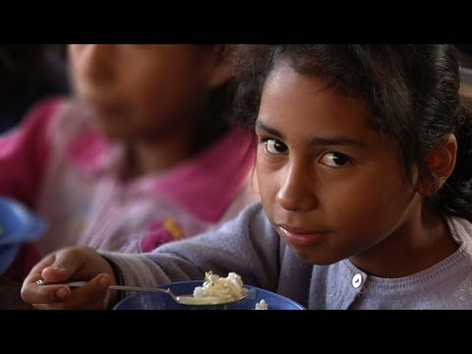

Slide 10
Learning Outcomes:
You will identify the components of living standards, and the connections to urbanization and globalization.
You will identify the causes of poverty in the developing world and how poverty is measured differently.

Slide 11
Task 1- Measuring Living Standards
Read Page 392-- Write down a list of 5 measurements that could be used to determine quality of life.
Share with a partner

Slide 12
Task 2:Urbanization
Read Pg. 393
Has moving to cities helped the plight of the poor?
List reasons (4)why the poor move to the cities.
Describe issues that urban areas are facing?

Slide 13
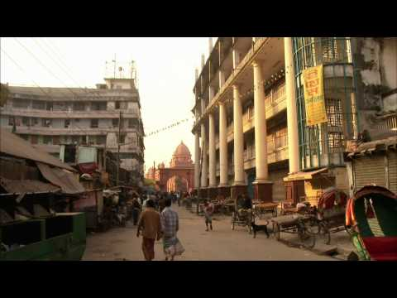

Slide 14
Task 3. Globalization-- Pg. 393
List (3) postives and(3)negatives of Globalization regarding its impact on living standards..

Slide 15
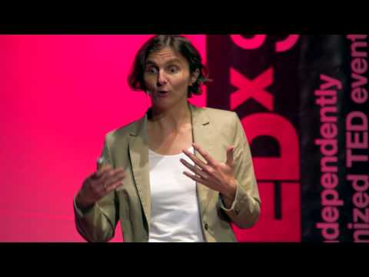

Slide 16
Task 4 -Measuring Poverty
1. How is poverty measured commonly? How many people live in poverty?
2. How is poverty measured in the U.S and Canada?
3. How does the UN measure poverty? Figure 12-8
4. What UN factor from 12-8 do you think is the most important?

Slide 17
Task 5.- Debt-- Pg. 396/397
1. What are the main causes of poverty?
2. Discuss the debt problem: Use GLM 13 to identify three debt problems and the effects on the developing world...(+ and -)
1.Megaprojects
2. SAP's
3.MNC's
4. HIPC's

Slide 18
Task 6-- Offshore Farming
Read 401- Answer #1 and #2

Slide 19
12-3 Poverty and Women/ Children

Slide 20
Learning Outcomes: How does poverty affect women and children..
How can improving women's status improve poverty...

Slide 21
Task 1: Assigned Topic and Reading
1.Life of a Women- Read "The position of Women" and Go over Figure 12-18
2.Education is the Solution- Read 402
3. Women in Niger/Developing Countries- Read 403
4. Children In Crisis-Read 404 and Figure 12-22
5. UFMR- Read Page 405
6. Children at War- Read 406-Up Close.
7. Read Working Children-Read 407/408

Slide 22
Task 2 ---Use the information that you read to answer the following questions... That you will share to your group..
How are women/children affected by poverty?
What are the main issues they face?
Rank the top three issues?Give a reason for your ranking..
Are any solutions evident?How is the world helping?

Slide 23
Meet in groups and share your 4 points....
Each person must jot down the answers to those 4 questions...
Use GLM-7 or your own web..
This is a hand in assignment..

Slide 24
Task 3- Poverty Web
Use the information gathered from each of the person who discussed their topic to create a Poverty Web....
Divide the web into two halfs-
Identify the problem and possible solutions that are being attempted.

Slide 25
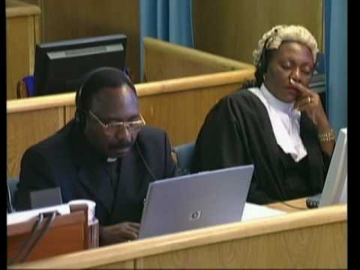

Slide 27
12-4- The Health Crisis and Solutions
Living Standards

Slide 28
Learning Outcomes:
Students will identify the primary diseases that are prevalent in the developings countries..
You will also infer as to how this impacts their economic growth...
You will also identify how foreign aid is delivered and how Canada participates in helping developing countries..

Slide 29
Task 1
Read your specified topic::
1. Water -Pg.. 409
2. Malaria- Pg 410
3. HIV- Pg. 411/412
1.After reading explain the dangers of this disease or how water contributes to diseases.
2. Explain possible solutions to this problem.
3. Speculate: How do you think this problem impacts the local economies..

Slide 30
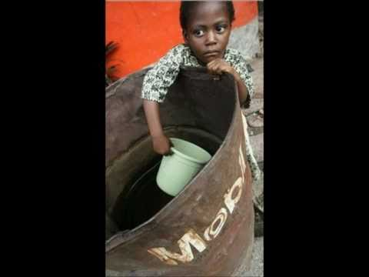

Slide 31
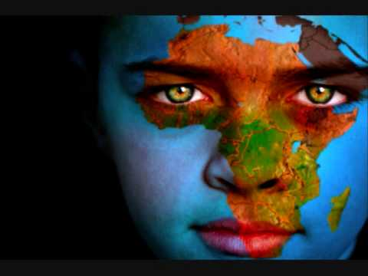

Slide 33
Share your issues with a small group..

Slide 34
Task 2
Foreign Aid----Canadian Aid
1. Read 413/414-Foreign Aid
2. Read 415/416/
Fig12-36--Canadian Aid(CIDA)
Describe each the above in detail and explain the differences.

Slide 35
Share your Definition with a partner who will also fill out one for your topic...
You should have a concept definition organizer for both terms.

Slide 36
Task 3.
1. What is a NGO ?
2. What are examples?
3. How have they been successful?
4. Foreign Aid Issues-
Pg. Read 418/419.. Answer -Analyzing the issues: 1,2…
5. Discuss with a partner your view.

Slide 37
Living Standards Summative Review-
Learning Outcome: To identify problems and solutions to living standard
issues in the developing world.
Choose a country in the developing world to study include the following information.
----------------Display the country on a map------------------------------
Description of Human Development Index Information.
b. Describe the major issues of poverty include examples such as: debt, women, disease,children, economic disparty, pollution, employment. and anything else that is relevant.
Provide specific examples with facts and information about
c. What is being done to solve the problems in this country from both local, governmental, and non-governmental organizations? Describe in detail the help that is being provided?
d. Is any progress being made with regards to the poverty issues?Provide specific examples.
e. In your viewpoint what are the major issues that are holding back the living standards of this country.

Slide 38
Rubric: Question A:Description of Human Development Index Information.
Fully Meeting- Discusses HDI thoroughly and identifies key components of countries living standards.
Meeting- Discusses HDI and identifies key components of countries living standards.
Minimally Meeting- Addresses basic components of HDI
Not Yet Meeting-Does not clearly understand the components of HDI
Rubric Question B: Describe the major issues of poverty include examples such as: debt, women, disease,children, economic disparty, pollution, employment. and anything else that is relevant.
Fully Meeting- Describes in excellent detail at least 4 different living standard issues.
Meeting-Describes in good detail three different living standard issues.
Minimally-Describes in satisfactory detail a number(2) of different living standard issues.
NYM- Insufficient description of living standard issues.

Slide 39
Rubric Question C:
What is being done to solve the problems in this country from both local, governmental, and non-governmental organizations? Describe in detail the help that is being provided?
Fully Meeting- Clearly identifies many different solutions from all of local, governmental, and non governmental
Meeting-Clearly identifies different solutions from some of local, governmental, and non governmental.
Minimally-Clearly identifies a few solutions from local, governmental, and non governmental organizations.
Not Yet Meeting.-Does not clearly identify solutions.
Rubric Question D: d. Is any progress being made with regards to the poverty issues?Provide specific examples.
Fully Meeting- Assesses progress in excellent detail with examples.
Meeting- Assesses progress in good detail with examples.
Minimally Meeting-Assesses progress in satisfactory detail with examples.
Not Yet Meeting- Does not assess progress

Slide 40
Rubric Question E:
e. In your viewpoint what are the major issues that are holding back the living standards of this country?
Fully Meeting- Identifies clearly and discusses in detail a issues that are impacting living standards.
Meeting:Identifies clearly and discusses i issues that are impacting living standards.
Minimally Meeting-Identifies clearly and discusses very basic issues that are impacting living standards.
Not Yet Meeting: Does not Identifiy or clearly discuss issues that are impacting living standards.

